Slide 1

Diagnosi e gestione dell’osteomielite cronica multifocale ricorrente (CRMO)
Protocollo del 21/12/2016
Tutor
Prof.ssa M. Alessio
AIF
Dott.ssa F. Orlando

Slide 2
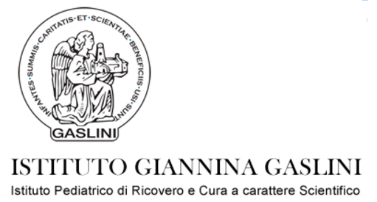


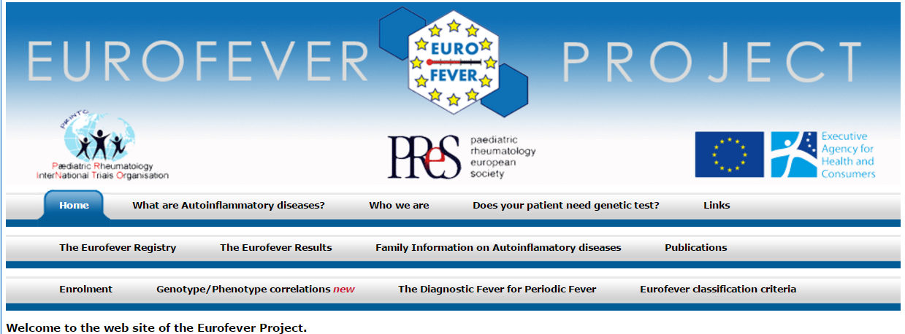
Notes:
Because of a high frequency of musculoskeletal disorders in children/ adolescents, it can be quite challenging to distinguish CRMO/ CNO
from nonspecific musculosketetal pain or from malignancies

Slide 3
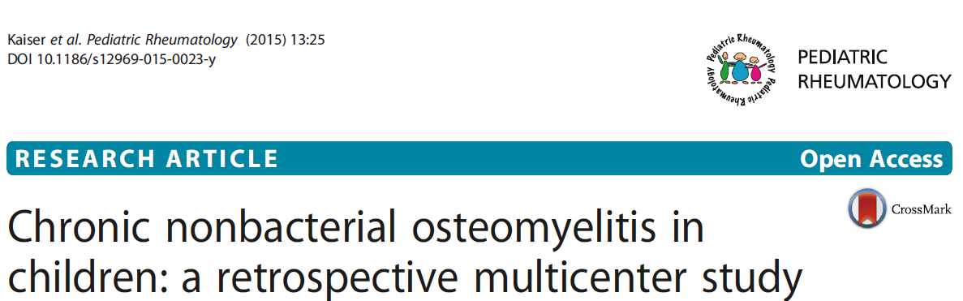
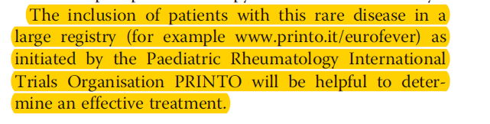
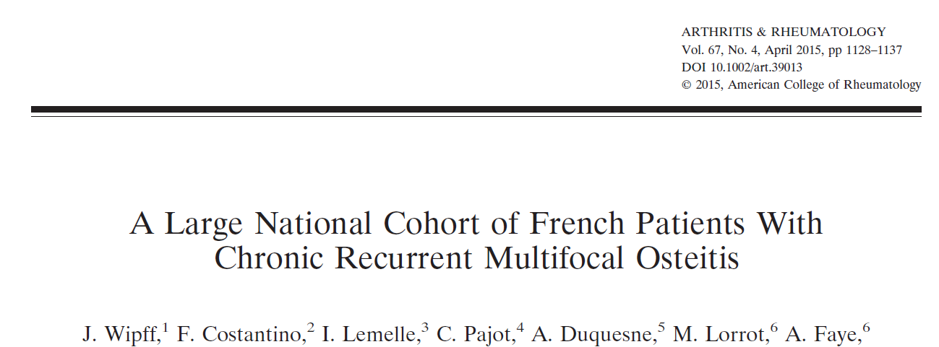
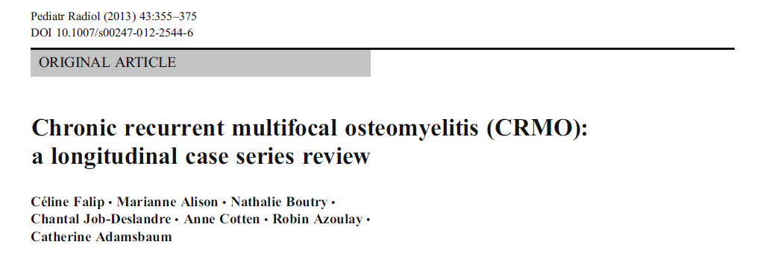

Slide 4
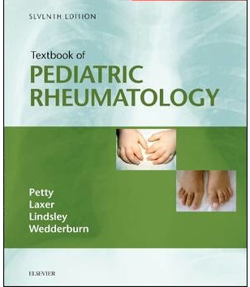
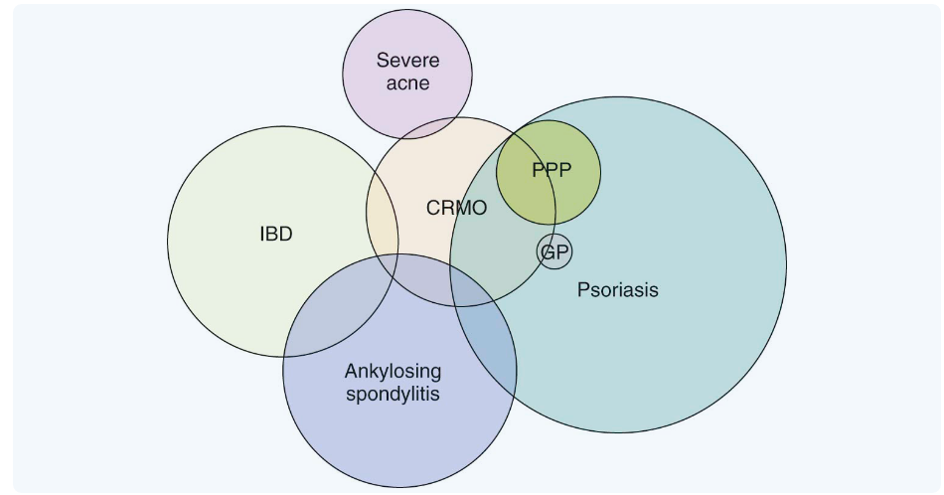
chronic recurrent multifocal osteomyelitis (CRMO)
Disordine autoinfiammatorio caratterizzato da episodi di infiammazione sterile dell’osso
F:M 2-4:1
ESORDIO 7-12 anni
Numero delle lesioni variabile (1-18)
Sedi più coinvolte metafisi ossa lunghe, clavicola, vertebre e pelvi
Interessamento simmetrico nel 25-40% dei casi
Familiare con disordine infiammatorio (50%)
Esordio prima dei 2 anni
- Majeed syndrome
- DIRA, deficiency of interleukin-1 receptor antagonist
SAPHO Synovitis Acne Pustolosis Hypeorostosis Osteitis
Notes:
Autoinfiammatorio disordine dell’immunità innata
Raro prima dei due anni. La maggior parte in infanzia ed adolescenza, ma anche adulti
At any one time, the number of osteomyelitis lesions can vary from one to 18. The symptoms may be intermittent or chronic and persistent, lasting from months to as long as 20 years. However, many individuals instead have chronic unremitting symptoms that may vary in severity.

Slide 5
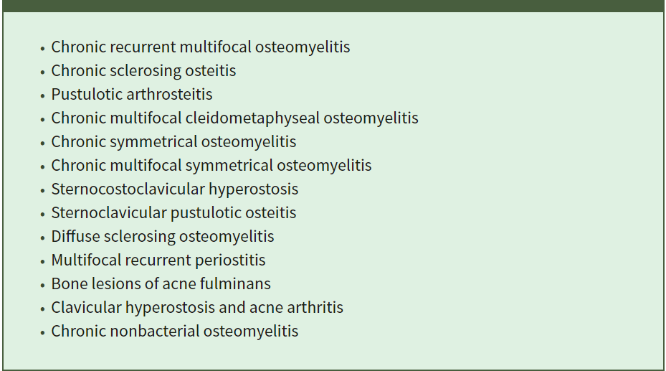
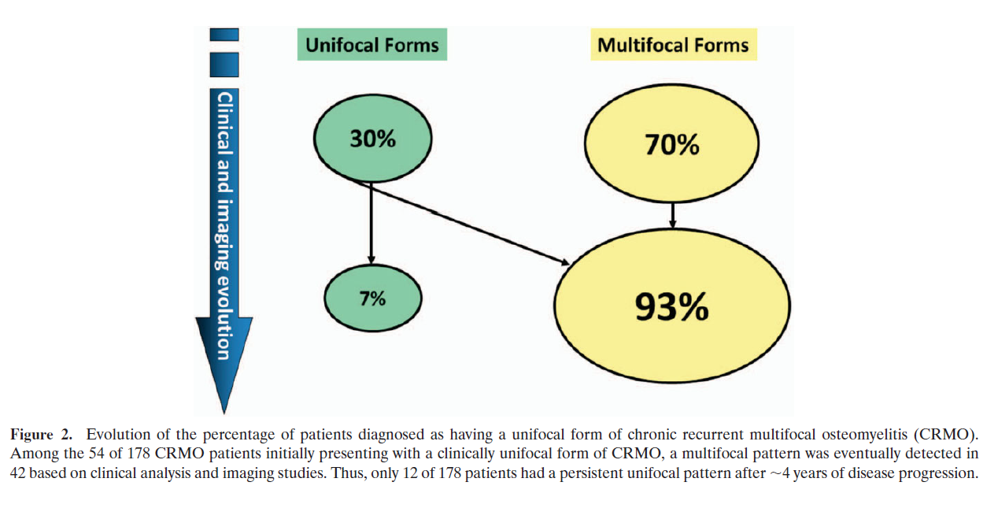
chronic recurrent multifocal osteomyelitis (CRMO)
Entità nosologica dal 1972
Nomenclatura
CNO Chronic Nonbacterial Osteomyelitis
NBO Non Bacterial Osteitis
CRMO Chronic Recurrent Multifocal Osteomyelitis
Unifocale ricorrente
Unifocale non ricorrente
Multifocale persistente
Multifocale ricorrente
Wipff at al, 2015
Notes:
Peristente >6 mesi
Chronic nonbacterial osteomyelitis (CNO) is a relatively rare pediatric rheumatic disease first described by Giedion et al. [1]. The 4 patients he reported suffered
from “symmetrical” bone pain. Pain remains the cardinal feature of CNO. Symptoms of general disease as one would expect in acute infectious osteomyelitis were absent.
Similarly, in a cohort reported by Girschick et al. of 30 pediatric patients with sterile osteitis, 30% had unifocal nonrecurrent disease, 10% had unifocal recurrent disease, 30% had multifocal nonrecurrent disease and 30% had classic CRMO

Slide 6
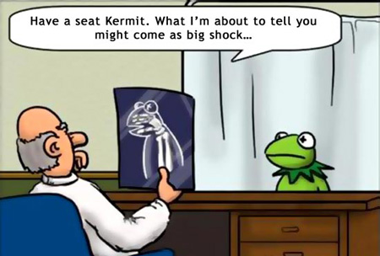
Aniello, d.n. 22/8/1998
Marzo 2012 dolore gin sin. Mai risvegli notturni.
Valutazioni ortopediche: dolori di crescita o post traumatici
Cicli terapia antinfiammatoria con risoluzione e ripresa
Febbraio 2013
Esami di laboratorio: PCR 12,1 mg/L VES 30
Maggio 2013 esacerbazione e comparsa di dolore gin dx.
FANS all'occorrenza
A novembre 2013 dolore e tumefazione caviglia dx
Valutazione ortopedica e.o. dolore e tumefazione gin dx e caviglia dx
Notes:
serale e dopo sforzo, associato a limitazione all'estensione della gamba.
Cicli 10 giorni
(maggio 2013) peggioramento del dolore
Indici di funzionalità epatica, renale, emocromo, ferritina.

Slide 7

Valutazione reumatologica
Esami ematochimici ed ecografia
Trattamento all’occorrenza

Slide 8
PCR 36,9 mg/l VES 60 Autoimmunità negativa
Ecografia ginocchia e caviglie: edema dei tessuti molli periarticolari
RM caviglia destra e ginocchio destro evidenza di edema intraspongioso a carico del III medio-distale della tibia e del calcagno e dell'epifisi distale del femore
Dicembre 2013 Reumatologo
EO: tumefazione bilaterale delle caviglie con modesta limitazione funzionale
Notes:
GB 5100 GR 4670000 Hb 12,5 PLT 290000

Slide 9
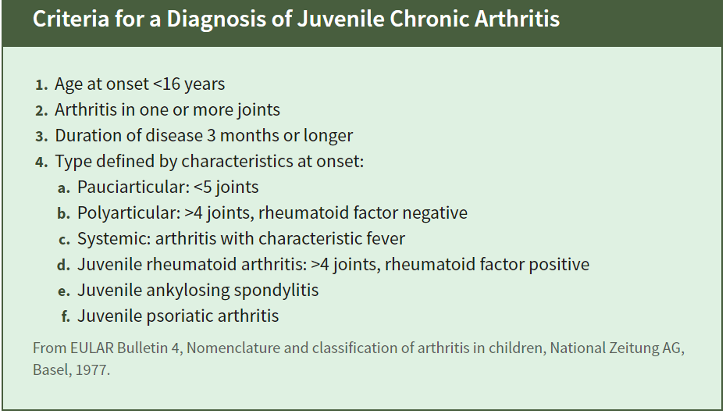
Scintigrafia ossea: incremento di captazione del radiocomposto a livello delle
ginocchia e caviglie bilateralmente; iperaccumulo anche a livello delle
articolazioni scapolo-omerali, sterno- claveari, radio-carpiche e sacro-iliache.
DIAGNOSI: AIG POLIARTICOLARE FR NEGATIVO
DIAGNOSI: SOSPETTA CRMO
DELTACORTENE 25 mg/die
Febbraio 2014 Ambulatorio Reumatologia pediatrica
Notes:
Scintigrafia polifasica e total body con 600mMBq di 99m Tc MDP. In fase di equilibrio ematico incremento della captazione…
In fase metabolica tardiva iperaccumulo
Avviata terapia con Deltacortene per os → ottima risposta clinica e normalizzazione indici di flogosi
Ripresa della sintomatologia al tapering dello steroide fino a sospensione il 26/02/2014
Nuovamente avviato Ibuprofene 600 mg 2 vv/die.

Slide 10
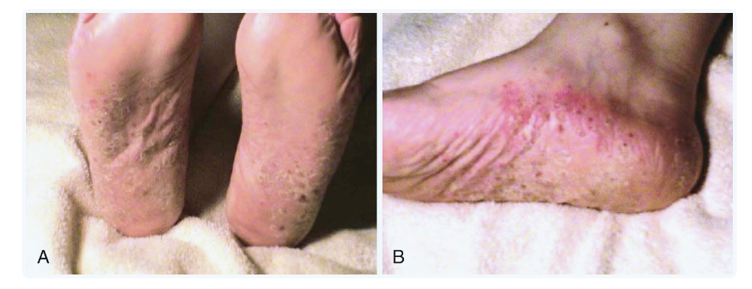
Manifestazioni cliniche
Dolore osseo ± febbre
Tumefazione
Aumento del termotatto
Malessere ed astenia
Manifestazioni extraossee associate (25%)
cutanee pustolosi palmoplantare, acne, psoriasi
gastrointestinali Morbo di Crohn
Notes:
The typical clinical presentation of CRMO is local bone pain with or without fever. The pain is typically worse at night. Onset is usually insidious, although some patients present with acute pain. Tenderness, swelling, or warmth are often present overlying the involved bone but may be absent.
The local swelling involving the soft tissues adjacent to the inflamed bone may mimic arthritis when the lesions affect the metaphyseal regions of the long bones. Clavicular lesions often present with marked swelling and tenderness, most often involving the medial one third of the bone (Fig. 48-3). When the pelvis or vertebrae are involved, the patient presents with pain (local or referred), limp, or pelvic girdle weakness. Synovitis may accompany the bone lesions and can occur distant from the sites of bone involvement. In one study 80% of patients had been diagnosed with arthritis in joints adjacent to the lesion; some had synovial biopsies that revealed histologic evidence of synovitis. Fever accompanies the bone pain at presentation in 17% to 33% of patients. Most often the affected individuals appear well, although many complain of malaise and fatigue. Twenty-five percent of CRMO patients present with an extra osseous manifestation, most commonly a pustular rash on the palms and soles(Fig. 48-4).

Slide 11
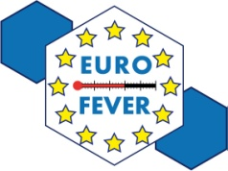
464 patients (99,5 %)
87 patients (19 %)
N of patients
N of patients

Slide 12

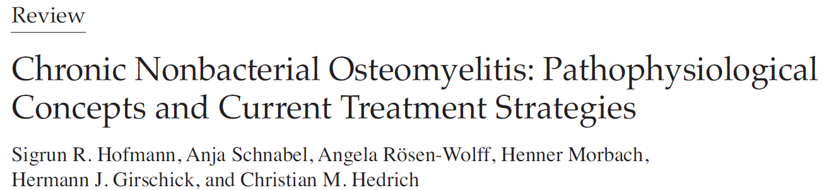
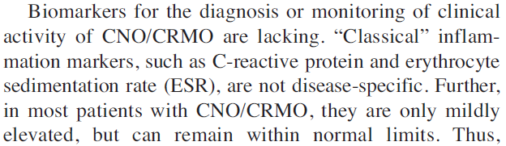
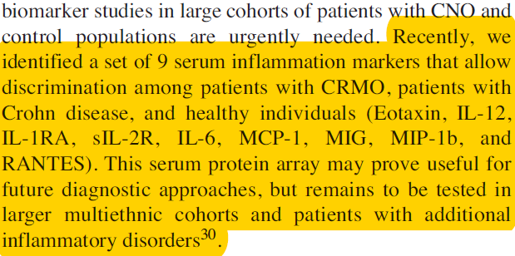
ESAMI DI LABORATORIO NON DIRIMENTI
No autoimmunità
COLTURE STERILI
Notes:
The majority of affected individuals have modest elevations of the erythrocyte sedimentation rate and C-reactive protein. White blood cell counts are typically normal or only mildly elevated. High titer autoantibodies are typically absent and there is no strong association with HLA-B27. Tumor necrosis factor alpha (TNF-α)^{66,101} and interleukin-6 were elevated in the serum of patients with CNO, suggesting a role for these cytokines in the pathogenesis of the disease.
Twenty two patients (54 %) received at least one course of intravenous antibiotics before the diagnosis was made.

Slide 13
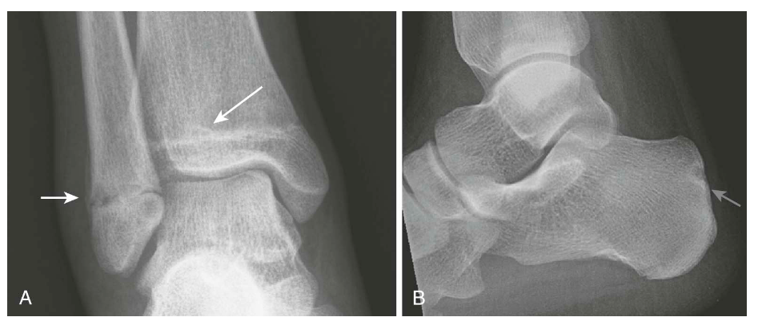
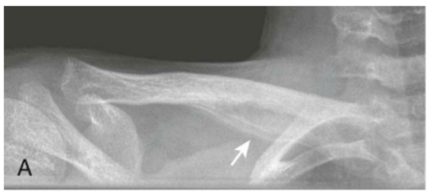
radiografia
Valutazione aree limitate
Bassa sensibilità
Notes:
A: lesioni osteolitiche con sclerosi circostante alla metafisi distale della fibula e della tibia
B: lesioni osteolitiche con sclerosi circostante al calcagno
Clavicola: clavicola destra sargata nei due terzi mediali con associata reazione periostale.

Slide 14

Dh reumatologia marzo 2014
Esame obiettivo articolare: Tumefazione, dolore e limitazione funzionale a carico delle caviglie bilateralmente. Dolore a carico delle ginocchia con dubbia tumefazione a sinistra. Modesta dolorabilità alla pressione a carico delle articolazioni sacroiliache
Esami di laboratorio: Hb 12,7 g/dl, VES 6 mm/h , PCR 0,58 mg/dl, SieroAmiloide 6.8 mg/l Gb 7230/mmc
RMN total body che mostrava iperintensità in STIR all'epifisi distale della tibia sinistra e dell'astragalo, calcagno e tarso di entrambi i piedi. Iperintensità in STIR alle epifisi femorali distali e tibiali prossimali; sfumata iperintensità delle metafisi-diafisi femorali distali di entrambi i femori. Iperintensità di segnale in STIR alla branca ischiatica destra e al collo femorale destro. Non evidenti altri reperti da menzionare
Notes:
PCR 0,58 mg/dl (<0,46), SieroAmiloide 6.8 mg/l (<6)

Slide 15
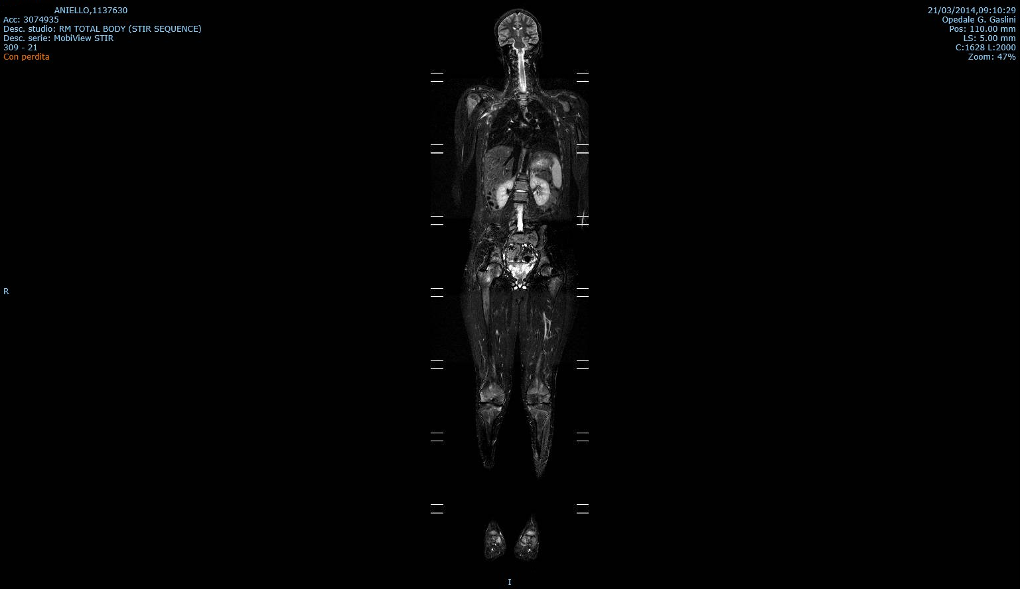
Notes:
all'epifisi distale della tibia sinistra e dell'astragalo, calcagno e tarso di entrambi i piedi. Iperintensità in STIR alle epifisi femorali distali e tibiali prossimali; sfumata iperintensità delle metafisi-diafisi femorali distali di entrambi i femori. Iperintensità di segnale in STIR alla branca ischiatica destra e al collo femorale destro. Non evidenti altri reperti da menzionare

Slide 16
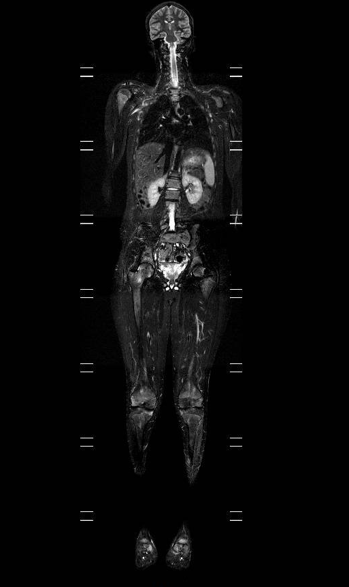
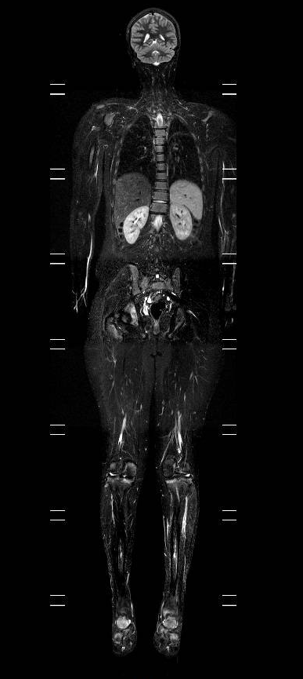
Iperintensità Collo femore
Iperintensità Ischio
Iperintensità piedi

Slide 17
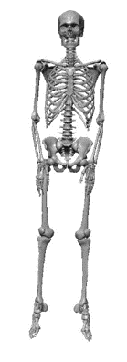
Cranium 3%
Clavicle 19%
Vertebra 23%
Thorax 10%
N of patients
Pelvis 25%
Carpus 3%
Epiphysis 23%
Diaphysis 15%
Methaphysis 37%
Tarsus 15%
Notes:
The disease may affect virtually any bone of the body, but the metaph­yseal regions of the long bones, clavicle, vertebral bodies and pelvis are the most commonly affected sites.^{27,66,67,69,70,103,106,107} Involvement is symmetric in 25% to 40% of individuals.^{66,69}

Slide 18
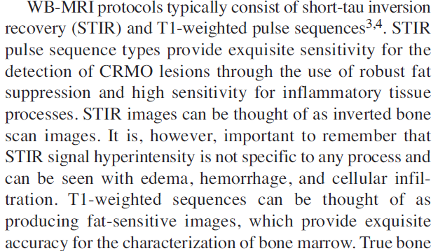
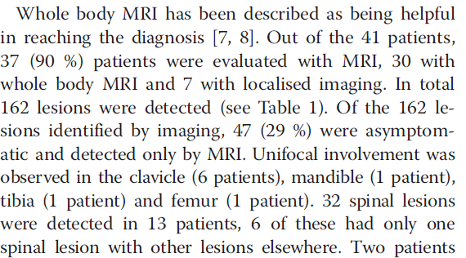
Whole body MRI
Lesioni clinicamente silenti
Maggiore sensibilità della scintigrafia
Assenza di radiazioni ionizzanti
Studio tessuti circostanti
Diagnosi e follow up
Fritz, J Rheumatol 2015
Ipointensità in T1 ed iperintensità in STIR
Notes:
multifocalità
A notorious characteristic of CRMO appears to be the discrepancy between a frequently underestimated burden of osseous inflammation based on clinical examination, laboratory inflammatory markers, and radiography, and the actual number of osseous inflammatory foci demonstrated on whole body imaging
In addition, the superior soft tissue resolution of MRI affords the accurate characterizations offascia, muscles, tendons, ligaments, vessels, and nerves, which can yield important information toward the differential diagnosis.
Plain radiograph of the major symptomatic site was available in 36 out of 41 patients. It was abnormal in 28/36 (78 %) revealing lytic lesions in 18 (50 %), areas of sclerotic bone in 19 (53 %) and periosteal reaction in 12 patients (33 %). Among the eight patients with normal plain radiographs, the median length of symptoms was 3.5 months compared with 8.5 months in the abnormal groupWhole body MRI detected an abnormal lesion at the symptomatic site in seven of these eight patients with normal x-ray.

Slide 19
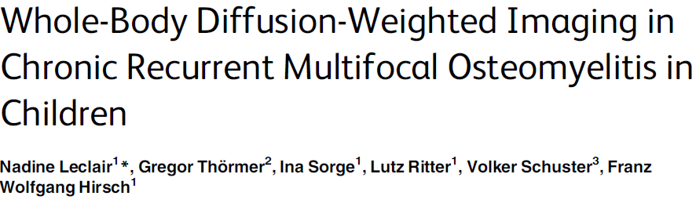
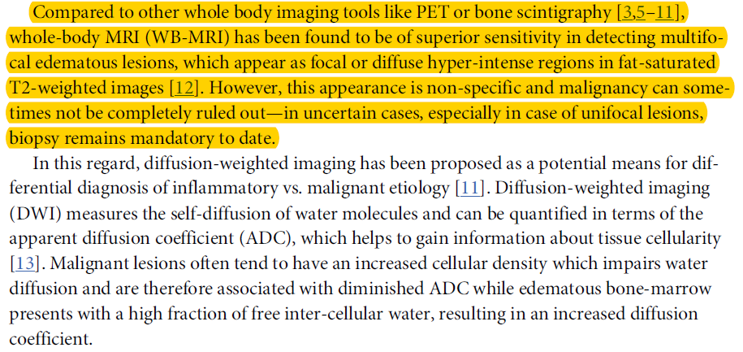
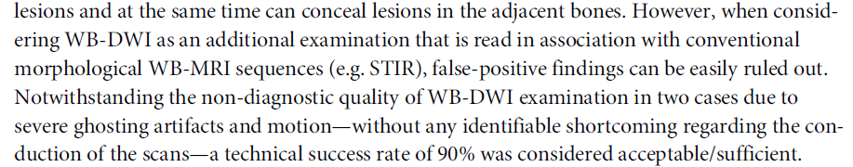
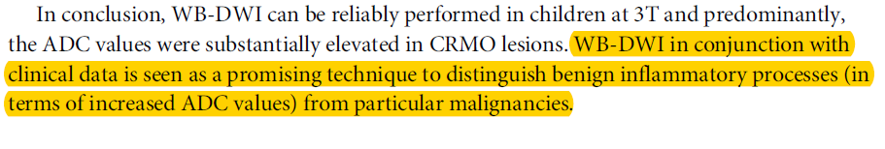
Notes:
Whole-body imaging at 3T was performed in 16 patients (average: 13 years) with confirmed CRMO. The protocol included 2D Short Tau Inversion Recovery (STIR) imaging in coronal and axial orientation as well as diffusion-weighted imaging in axial orientation. Visibility of lesions in DWI and STIR was evaluated by two readers in consensus. The apparent diffusion coefficient (ADC) was measured for every lesion and corresponding reference locations.
Clinically, DWI has been already shown to be useful to detect and to further characterize inflammatory bone marrow lesions in terms of relative changes of cellularity. With growing water content and increasing grade of inflammation, edematous bone marrow returns higher signal intensities in STIR sequences and higher ADC values [16–19]. One major challenge in interpretation of MR scans of the infant skeleton, however, is the signal appearance of bones in general: The normal adolescent and infant bone marrow pattern shows high signal intensity in STIR weighted images, especially near the epiphyses and high signal intensities are also
seen in DWI. Conditions that make it more difficult to interpretWB-MRI in children than in adults.

Slide 20
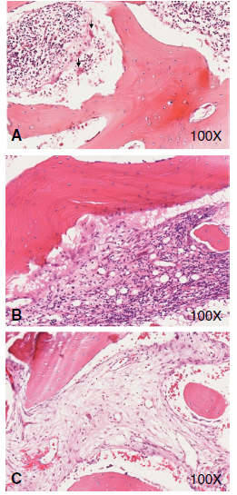
Biopsia ossea: quando?
Lesione unifocale e/o in sedi atipiche
Elevazione indici di flogosi
Alterazioni della linea bianca
Hedrich et al. Pediatric Rheumatology 2013
SEDE
Maggiore informazione con minori conseguenze funzionali ed estetiche
Notes:
Esclusione di eziologia infettiva e maligna

Slide 21
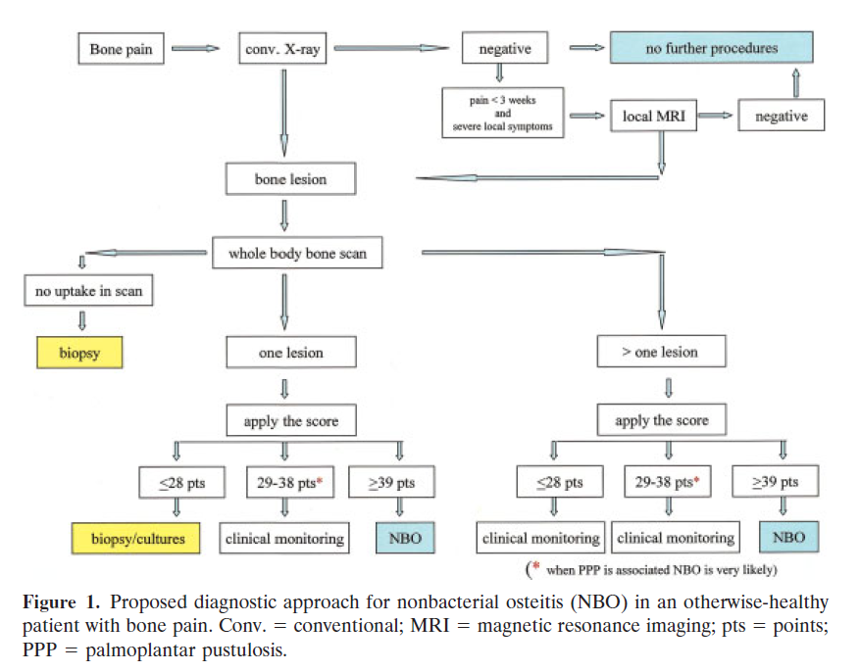
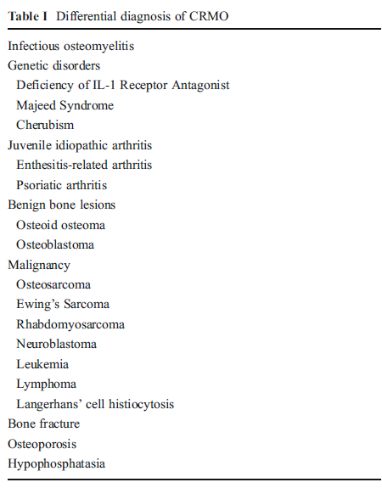
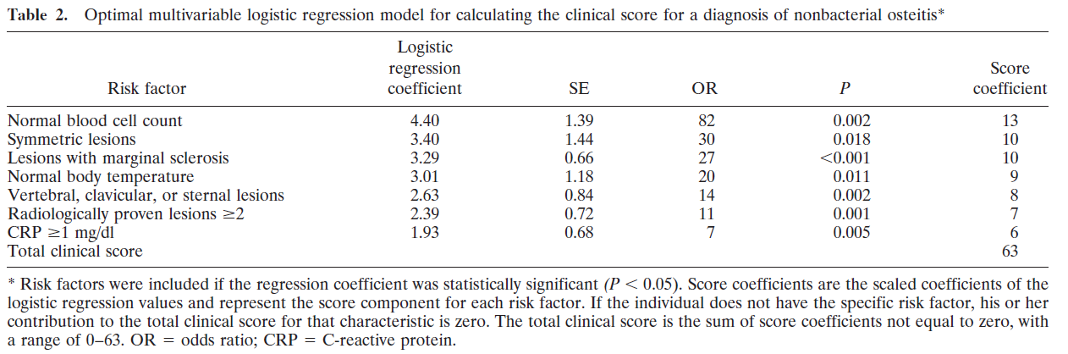
Notes:
. A clinical score can then be calculated that ranges from 0 to 63 with a score of greater than or equal to 39 generating a positive predictive value of 97% and a sensitivity of 68% in their cohort

Slide 22
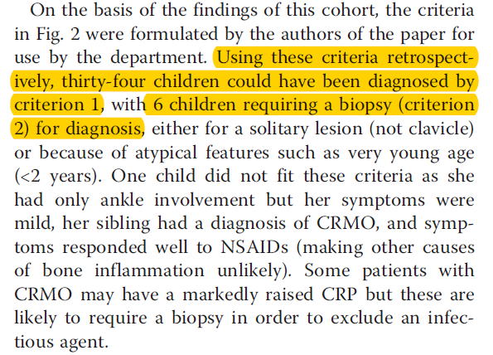
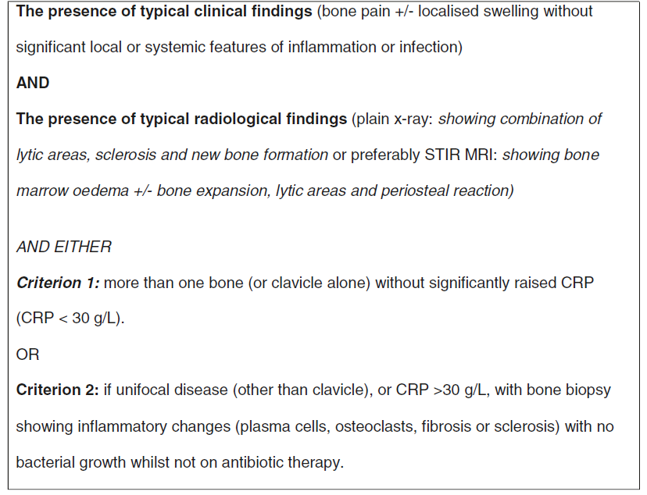
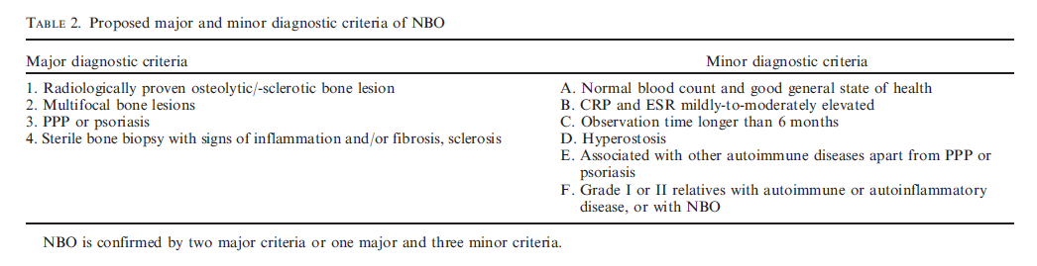
Assenza di criteri diagnostici validati
Jensson, Rheumatology (2007)
Notes:
Retrospettivo
41 pazienti
Over an 8 year period, 41 patients were diagnosed with CRMO. Symptom onset occurred at a median of 9 years of age and time to diagnosis had a median of 15 months (range 0–92). Correlation coefficient analysis for time to diagnosis by year showed statistical significance with a decreasing trend. From the cohort data, diagnostic criteria were developed; applied retrospectively, 34 (83 %) children may have been diagnosed using the criteria, without a biopsy.

Slide 23

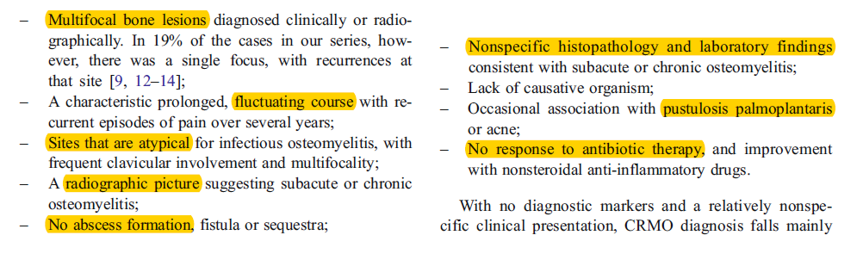
RITARDO DIAGNOSTICO!!!

Slide 24
Aniello, d.n. 22/8/1998
Aprile 2014 Ibuprofene a dosaggio pieno (600 mg x 3/die)
Miglioramento parziale dopo un mese di terapia
Ripresa alla riduzione
Che fare?
A Cambiare terapia
B Nuova RM
C Biopsia ossea
Notes:
ridotto a maggio 2014, in seguito a lieve miglioramento

Slide 25
Aniello, d.n. 22/8/1998
Luglio 2014
biopsia ossea astragalo sinistro: tessuto osseo e cute. Negli spazi midollari sono presenti sparse cellule infiammatorie, comprendenti alcune plasmacellule e fenomeni di edema. Sebbene i reperti microscopici non siano di per sé diagnostici, tenuto conto del quadro clinico, possono essere ritenuti compatibili con un quadro di osteomielite cronica

Slide 26
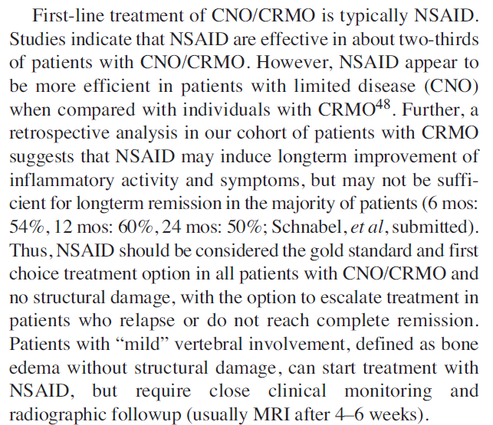
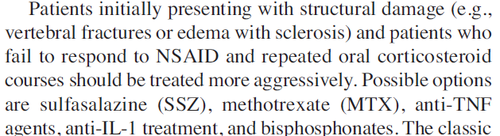
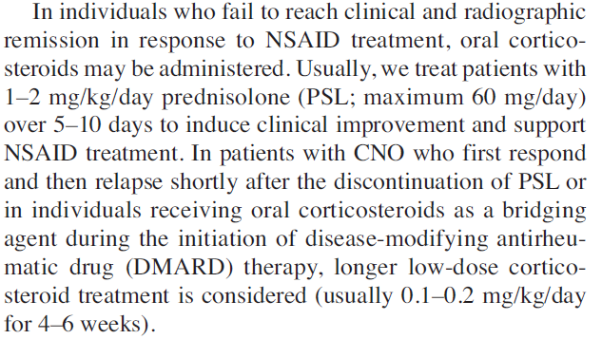
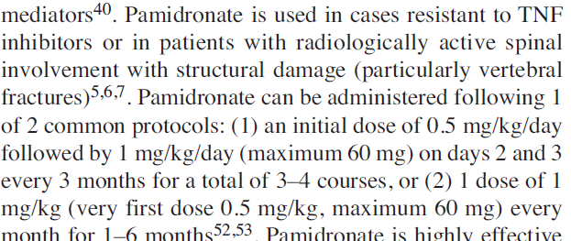
Notes:
Given the aforementioned observations in monocytes from patients with CRMO, therapeutic effects of NSAID and corticosteroids in a large proportion of patients can be explained (Figure 3). NSAID inhibit the activity of cyclooxygenases (COX), enzymes responsible for the conversion of arachidonic acid into prostaglandins. Prostaglandins are essential for the activation of osteoclast cells, which may be central to inflammatory bone loss in CRMO3. Within the same pathway, corticosteroids inhibit phospholipase A2 (upstream of NSAID), as well as COX, resulting in reduced
prostaglandin levels3. Further, corticosteroids inhibit nuclear factor-ĸB (NF-ĸB)-dependent gene activation, resulting in reduced expression of proinflammatory cytokine genes, including the genes for IL-6, and TNF-α

Slide 27
TRATTAMENTO
N of patients

Slide 28
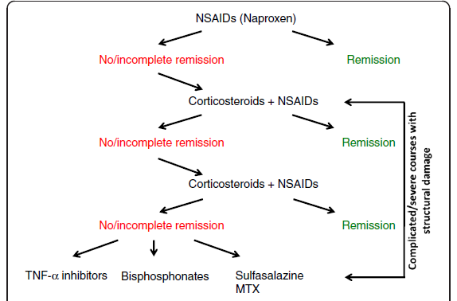
FANS
(Naprossene 10-15 mg/kg/die)
-
Salazopirina
(20 mg/kg/die)
Ciclo di steroide
(Prednisone 1-2 mg/kg/die)
+
Methotrexate
(15 mg/m²/settimana)
Anti-TNFα
(Etanercept 0,8 mg/kg 2 volte/settimana)
prevalente coinvolgimento periferico/cutaneo
II linea
III linea
I linea
Bifosfonati
(Pamidronato 1 mg/kg/die per 3 giorni consecutivi ogni 3 mesi o 1 volta/mese)
prevalente interessamento assiale
Hedrich et al. Pediatric Rheumatology 2013
Notes:
Ciclo steroide per 5-10 giorni

Slide 29

aniello
DAY HOSPITAL gennaio 2015
Persistenza del dolore caviglie trattato FANS (a giorni alterni).
RM STIR total body: Al controllo attuale focale iperintensità in STIR in adiacenza alla limitante superiore e al muro anteriore del soma di D11. Sfumata e lieve iperintensità a livello delle clavicole medialmente e lateralmente, degli olecrani ulnari e dell'omero distale bilaterale sul versante ulnare. Persistono lievi alterazioni di segnale a livello della porzione prox delle diafisi femorali con sfumate iperintensità in corrispondenza dell'epifisi distale del femore dx e della porzione prox della tibia sn. Attualmente solo sfumata iperintensità distale della tibia sn, dei peroni e di alcune ossa tarso- metatarsali bilateralmente. Alterazione di segnale delle parti molli della gamba dx.
Infusione di Neridronato 100 mg ogni 3 mesi per un anno
BIFOSFONATI

Slide 30
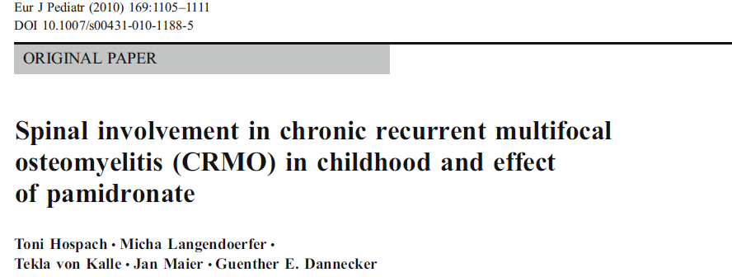
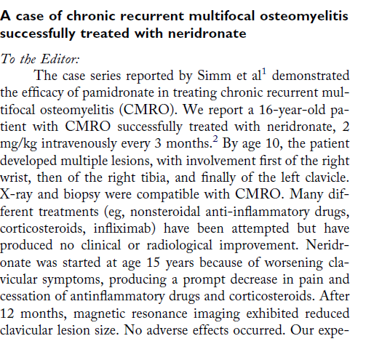
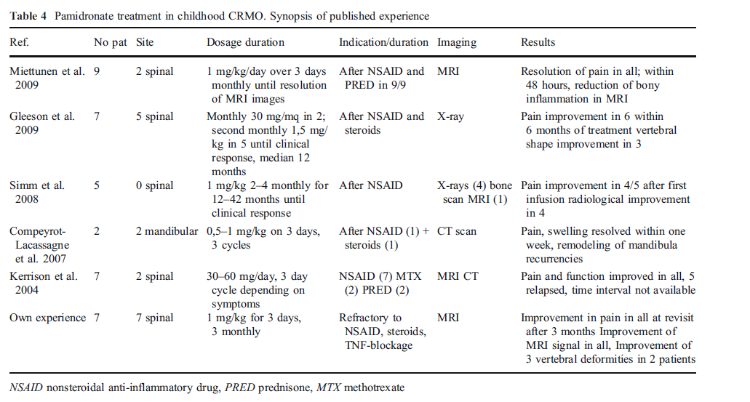
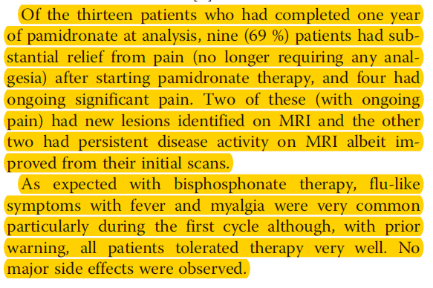
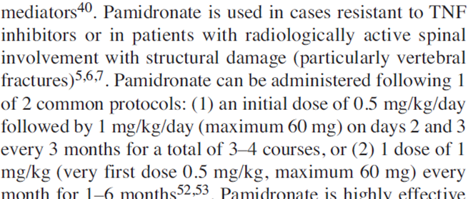
Notes:
Neridronato Trieste

Slide 31
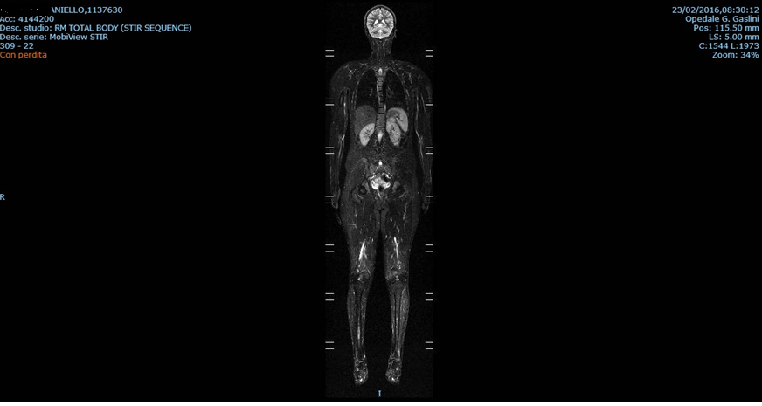
aniello
Notes:
WB con seq STIR e T1 pr piani coronali e sagittale.
Attualmente sfumata alterazione di segnale a T3 e diafisi della tibia destra.

Slide 32
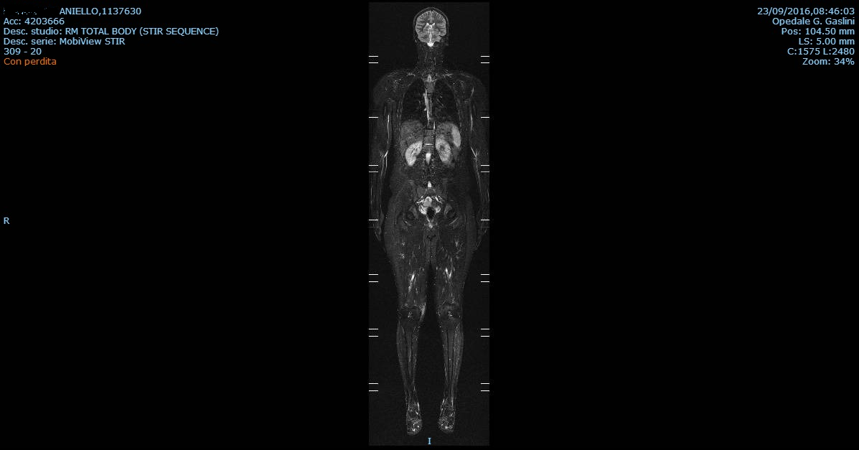
aniello

Slide 33
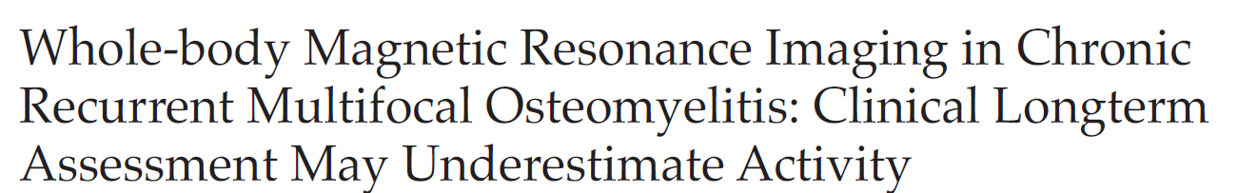

45% dei pazienti in remissione clinica presentava lesioni radiologicamente attive (silent lesion)
Follow-up annuale fino a risoluzione radiologica?
Quando trattare in assenza di sintomi?
Notes:
To the best of our knowledge, this is the first report presenting WB-MRI findings not only in symptomatic, but also in symptom-free patients diagnosed with pediatric CRMO more than 10 years ago.
Seventeen patients (82% women) who were diagnosed with childhood-onset CRMO at least 10 years (average 12) before reexamination were reevaluated. Patients completed a standardized questionnaire, and underwent clinical and laboratory investigation and WB-MRI. Clinical features were compared with imaging findings.

Slide 34


Slide 35

Patogenesi delle malattie autoinfiammatorie dell’osso
Costa-Reis, J Clin Immunol (2013)
P.J. Ferguson, Curr Rheumatol Rep. 2012
Hedrich et al. Pediatric Rheumatology 2013
Notes:
Other data support the hypothesis that CRMO is a member
of the vast family of auto-inflammatory diseases. The
occurrence of spontaneous attacks of inflammation, the
absence of high titer autoantibodies and autoreactive T cells,
the predominance of neutrophils in the early lesions, and
data regarding the genetic susceptibility for this disease [73],
all support its relationship to autoinflammatory diseases.
Monogenic autoinflammatory bone disorders
Pyogenic arthritis, pyoderma gangrenosum and
acne (PAPA)
PAPA patients present during childhood with recurrent
episodes of erosive arthritis, that in later disease stages may
require joint replacement therapy. As patients progress in puberty, cutaneous involvement with neutrophilic skin lesions
ranging from cystic acne to pyoderma gangrenosum
may predominate. PAPA segregates with mutations in the threonine
phosphatase-interacting protein (PSTPIP)1. Mutations
in PSTPIP1 result in impaired phosphorylation and
subsequently prolonged interactions with pyrin, resulting
in enhanced activation of the NLRP3 inflammasome
Majeed syndrome is an autosomal recessive disorder that presents with early-onset CRMO,
dyserythropoietic anemia that often is accompanied by recurrent fever, and may be
accompanied by a neutrophilic dermatosis (Sweet syndrome)
Three unique LPIN2 mutations have been identified in patients with Majeed syndrome.
It has been suggested that fatty acids may
induce a pro-inflammatory phenotype by toll-like receptor
(TLR)2 and 4 stimulation that result in the activation of
Mitogen Activated Protein (MAP) Kinases, particularly
Jun Kinase (JNK)1, and the induction of NLRP3 inflammasomes
(Figure 1C)
DIRA is an autosomal recessive, potentially life-threatening disorder that presents in the
neonatal period with generalized pustulosis, osteitis, periostitis, and systemic inflammation
due to mutations in IL1RN
The IL-10 expression is, therefore,
decreased, without pro-inflammatory cytokines, like
TNF-α or IL-6, being affected, which causes an imbalance
favoring pro-inflammatory cytokines.
In DIRA, PAPA and CRMO there is, therefore, an imbalance
between the pro-inflammatory and antiinflammatory
cytokines. This imbalance seems to be caused
by an increased IL1β expression in the case of PAPA,
decreased IL-1 receptor antagonist in DIRA and reduced
expression of IL-10 in CRMO.
35

